Slide 1

Sales Performance & Strategic Insights
Data analyst - Aironas Vinickas
2025 02 20

Slide 2
Today’s Agenda
YoY Revenue growth overview
Online vs. Offline comparison
Profit Margin vs. Revenue
Average Order Value overview
Average Profit Margin overview
Online Customer Acquisition trends
Sales reasons overview
Online Sales by Country

Slide 3
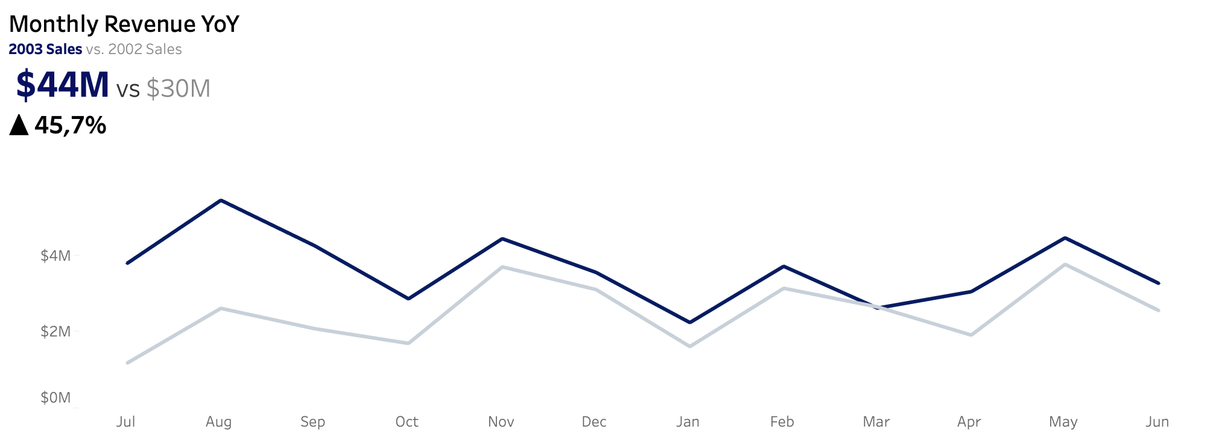
Year-over-Year Revenue - strong growth in 2003
Revenue grew by 46% YoY, reaching $44M in 2003 compared to $30M in 2002.
Growth momentum peaked in July and August possibly indicating strong seasonal demand and improved sales strategy. Sales pattern remains similar.

Slide 4
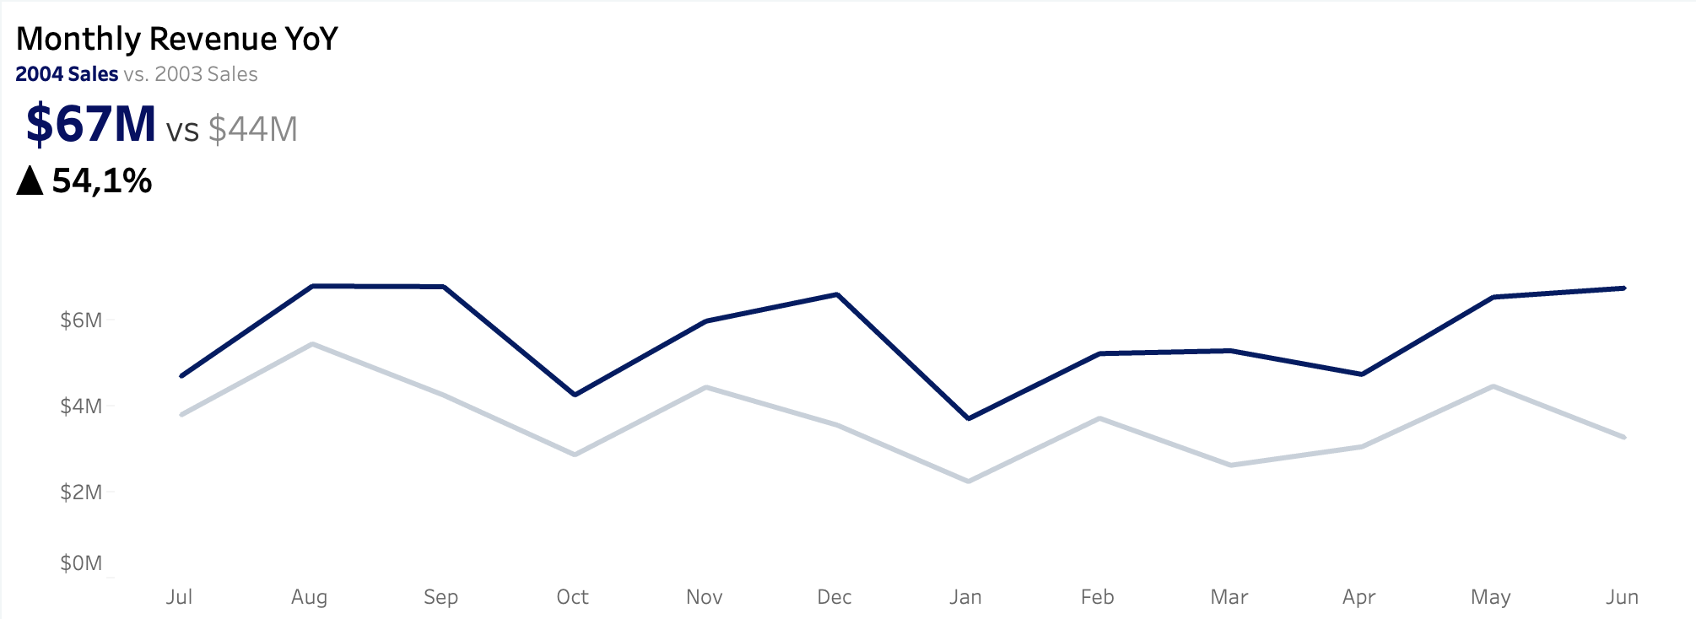
Year-over-Year Revenue - strong performance in 2004
Revenue surged by 54% YoY, reaching $67M in 2004 vs. $44M in 2003.
Notable spikes in September, December and March suggesting improved sales initiatives. Growth indicates continued momentum and possibly expanding market demand.

Slide 5
How does online vs. offline tendencies contribute to this?

Slide 6
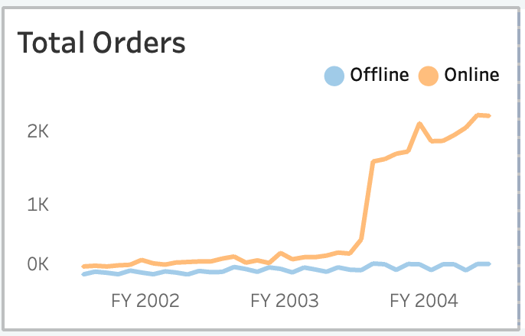
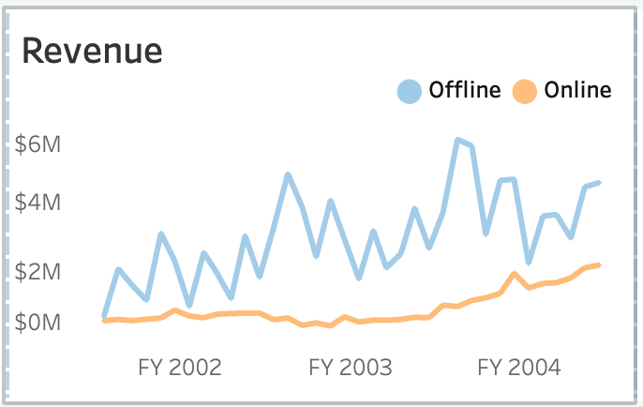
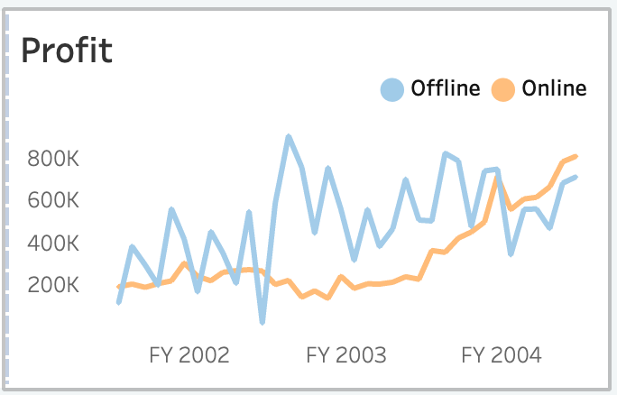
Online Sales Drive Growth - A Structural Shift in Sales Tendencies?
Significant increase in orders is driven by strong online sales growth – highlighting a possible shift in customer purchasing behaviour
Offline sales revenue remains higher but volatile while online sales revenue shows steady and sustainable growth.
Offline profit is generally higher but volatile, while FY 2004 marks a shift – online profit surpasses offline despite lower revenue.

Slide 7
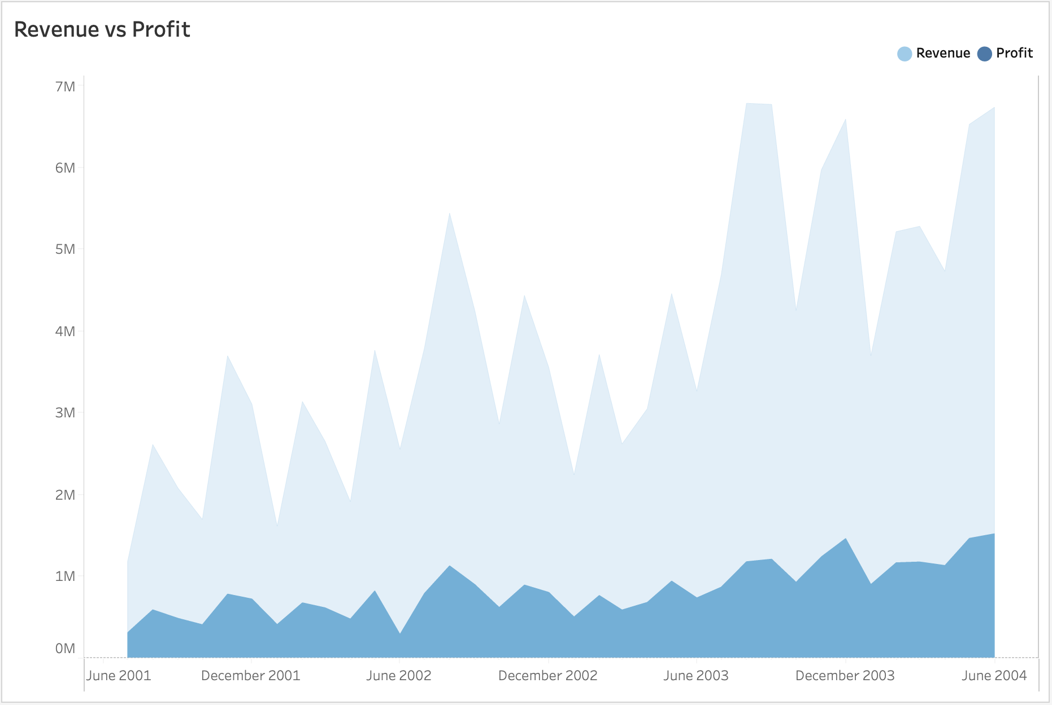
Are we sacrificing profit margins to drive revenue growth?
Revenue is growing rapidly, but profit is increasing at a slower pace. Lower-price strategy appears to be driving online sales and scaling revenue, yet profit growth remains modest.
How can we optimize profitability more while sustaining growth?
How is Average Order Value related to this?

Slide 8
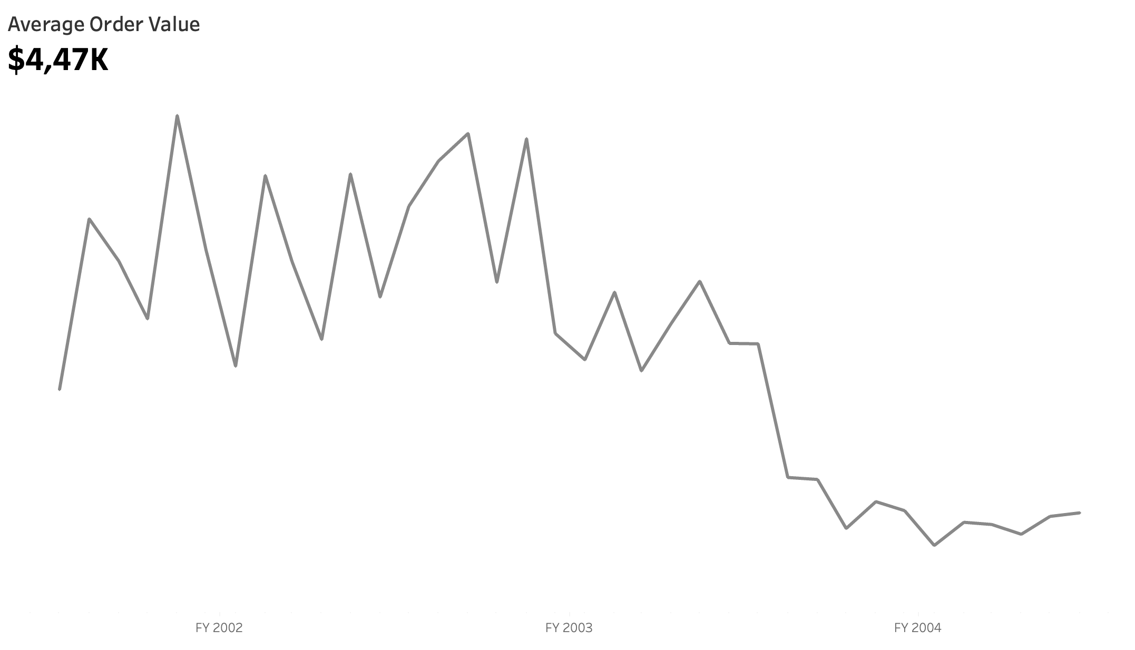
Average Order Value is Declining - Revenue Growth is driven by Volume
Despite strong revenue growth, AOV is declining and drops 50% in 2003 August vs. July – potentially related to a shift in pricing strategy
Could this be related to different customers behaviour Online vs. Offline?

Slide 9
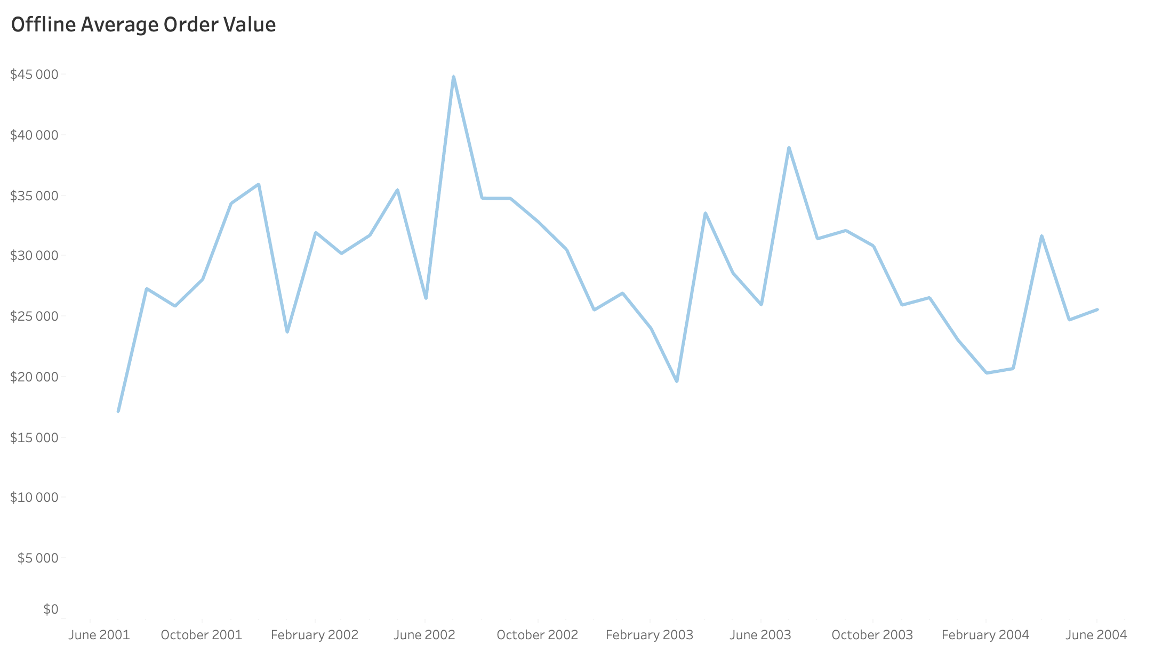
Offline sales AOV - no clear growth or decline
Offline AOV remains volatile but does not show a clear growth or decline pattern, indicating similar customer behaviour across years.

Slide 10
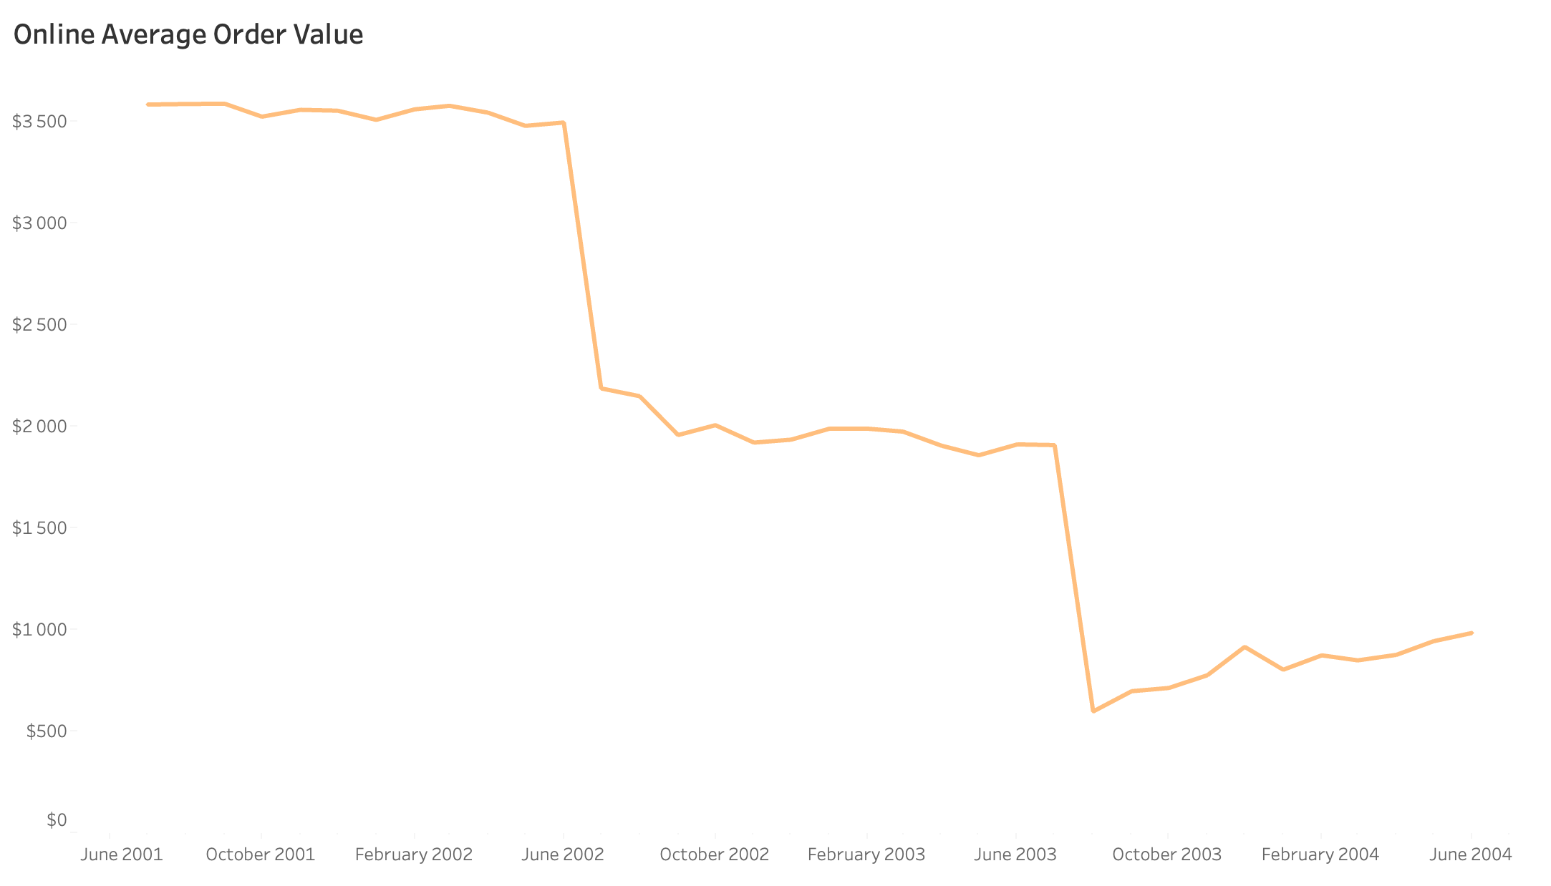
Online AOV Shows a Steady Decline
Online AOV has a clear declining pattern, forming a stair-step decline in trend. AOV drop occurs each July, suggesting promotional campaigns and/or shift in customers behaviour
How does this affect profit margins?

Slide 11
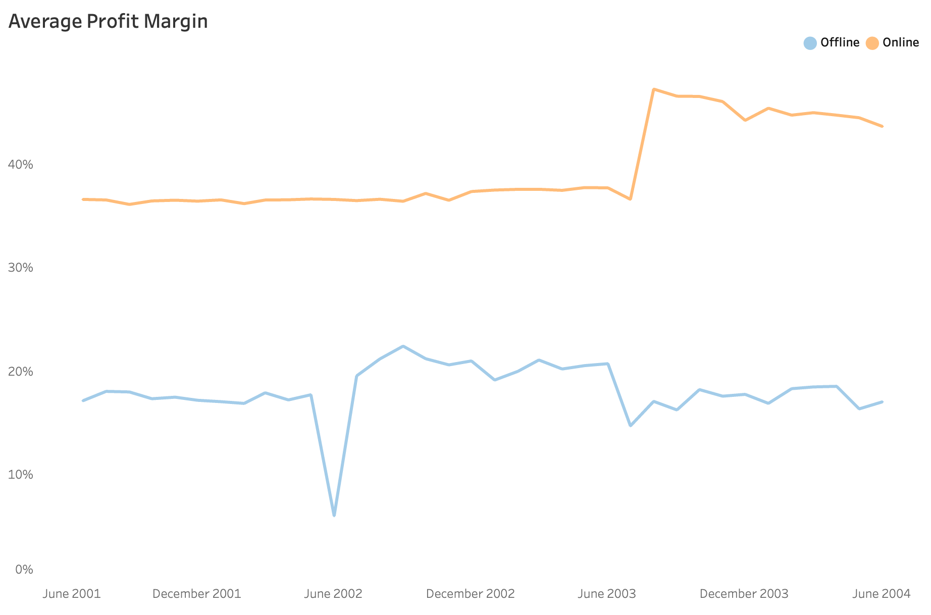
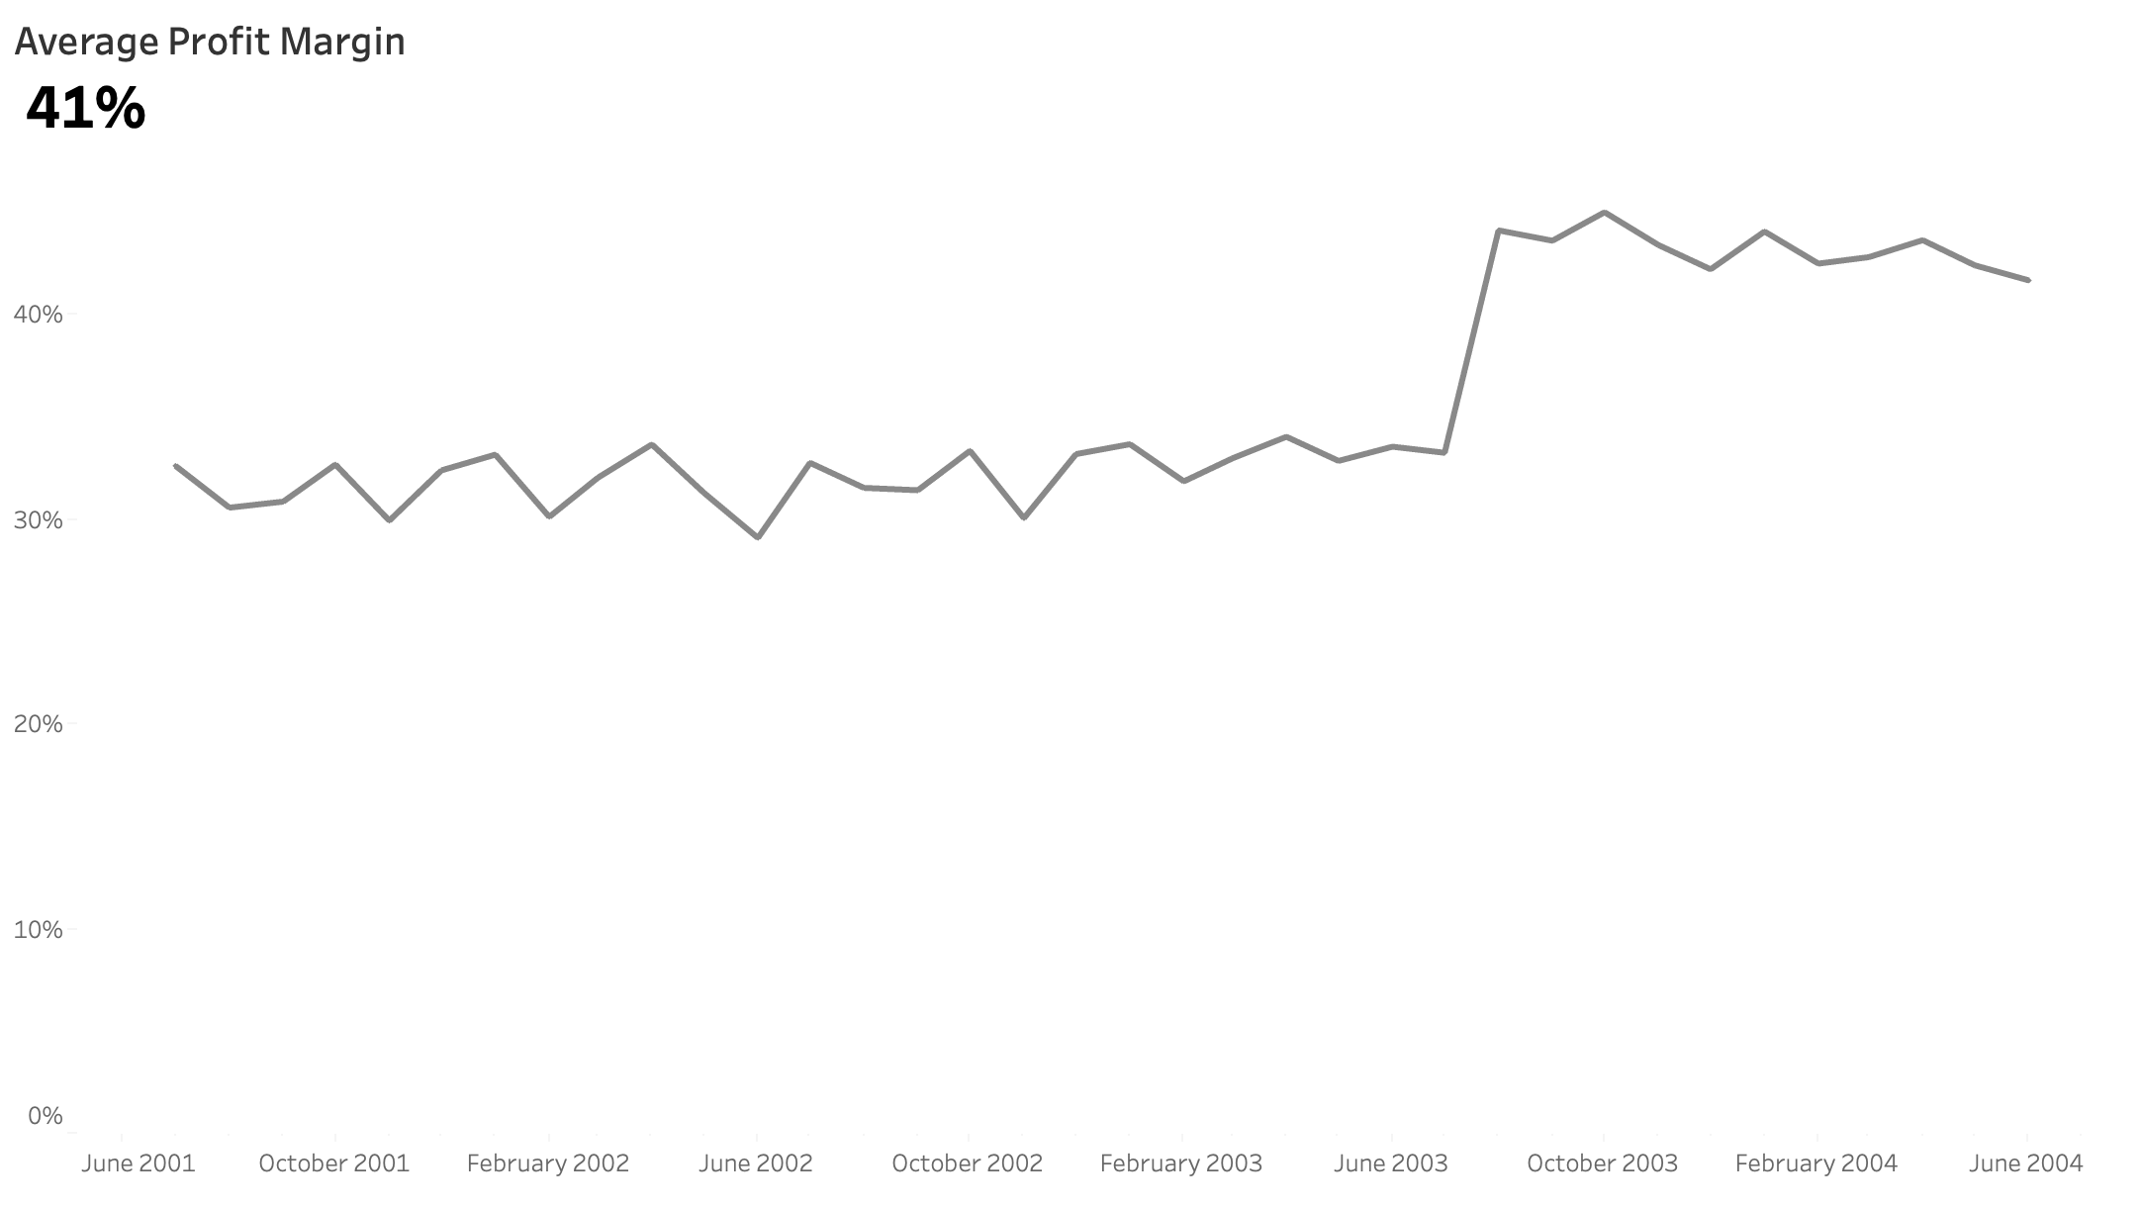
Average Profit Margin - Growth Driven by Online Sales
Spike in August 2003 is driven by online sales. Online profit margins are significantly increased, suggesting improved pricing strategy.
Average Profit Margin saw a significant growth spike in August 2003.

Slide 12
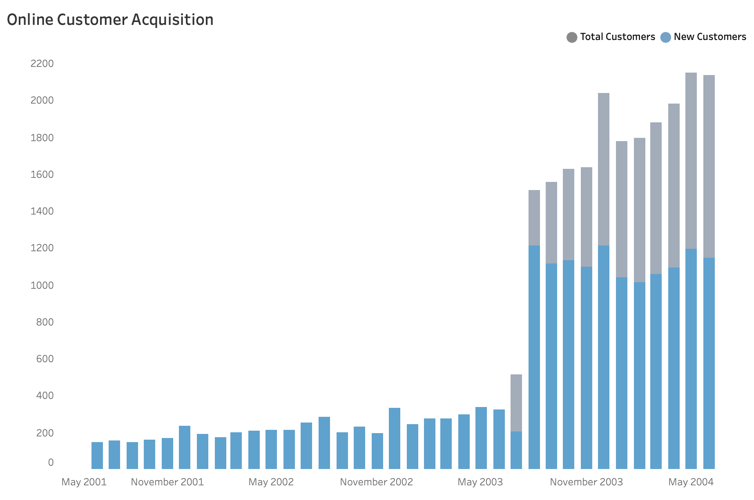
Online Customer Acquisition Trends - Strong Growth since August 2003
Until July 2003, nearly all online customers were new. Later total customer base grew significantly and is accelerating each month, indicating successful outreach, market penetration or increased demand
It is important to maintain customer retention alongside acquisition

Slide 13
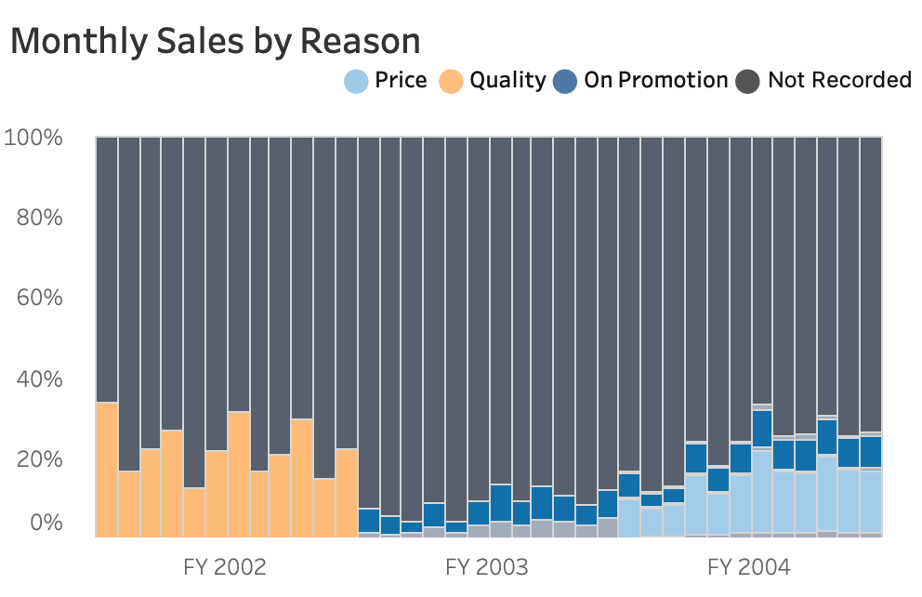
Price and Promotion: a potentially solid combination for Driving Online Sales
Quality declined as a factor and price spiked in 2004. Price and Promotion have the potential to be a strong combination for driving online sales. Looking ahead, how will we strategically position our products for sustainable growth?
What lies behind Not Recorded?
How to record Offline sales reasons?

Slide 14
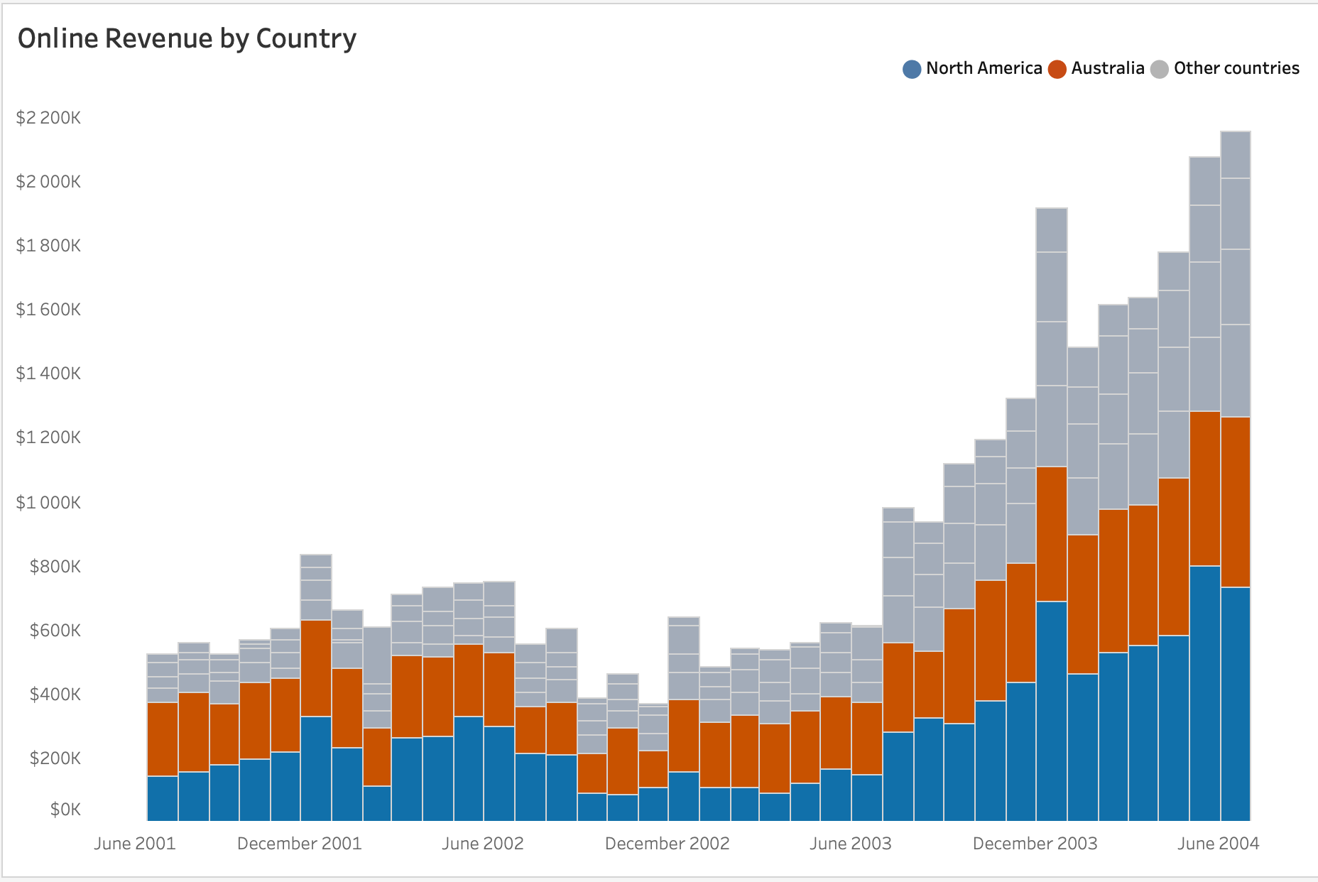
Growth opportunities: North America Leads in Online Sales. Are European and Canada online markets a challenge or opportunity?
North America dominate Online sales, while Europe and Canada lags – indicating potential growth opportunities.

Slide 15
Key Takeaways & Insights Summary
Orders, Revenue & Profit Growth is strong – primarily driven by increasing Online Sales
Offline metrics remain higher but volatile, online metrics indicates more steady and sustainable growth
Overall AOV is declining over time, Online AOV has a noticeable drop every July, Offline AOV remains more stable.
Customer acquisition shows a significant customer base expansion and continues to accelerate
Competitive price strategy alongside with promotion might be a strong combination to dominate in the market
North America leads in Online sales, European and Canada markets are falling behind

Slide 16
Action Plan for the Sales Team
- To ensure sustainable growth, consider how the brand is positioned in the market - quality vs. price - and refine the messaging to support a balance between pricing, quality, and customer experience.
- Sustain strong new customer growth and explore ways how to keep customers loyal (develop loyalty programs)
- Address underperforming countries challenges and market penetration opportunities by identifying barriers and adjusting strategy.
- Consider testing premium offers or bundling strategies to increase AOV without reducing sales (test strategic pricing adjustments)

Slide 17
Questions | Discussion

Slide 18
Unused additional slides

Slide 19
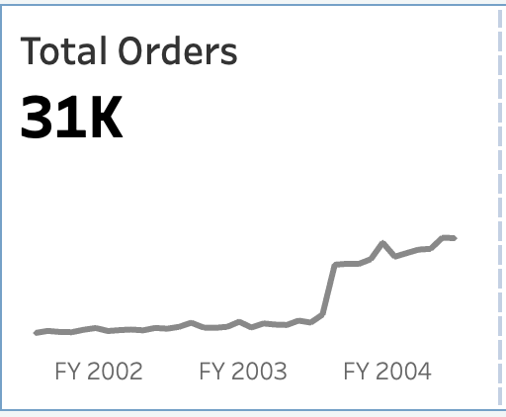
Strong Growth in Orders, Revenue & Profit – AOV Decline Signals Shift in Buying behaviour
Significant increase in orders amount by 189% in 2003 August vs. July – sustaining a strong upward trend

Slide 20
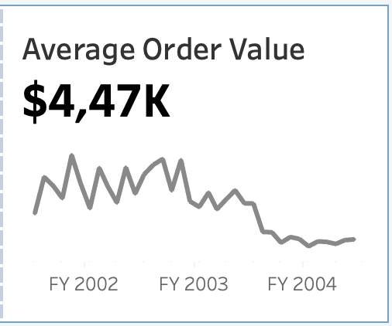
Strong Growth in Orders, Revenue & Profit – AOV Decline Signals Shift in Buying behaviour
Significant increase in orders amount by 189% in 2003 August vs. July – sustaining a strong upward trend
AOV drops 50% in 2003 August vs. July – potentially related to a shift in pricing strategy

Slide 21
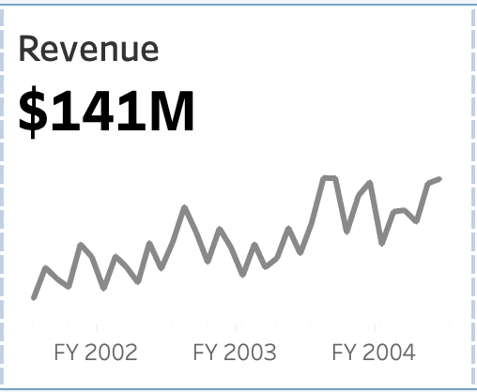
Strong Growth in Orders, Revenue & Profit – AOV Decline Signals Shift in Buying behaviour
Significant increase in orders amount by 189% in 2003 August vs. July – sustaining a strong upward trend
AOV drops 50% in 2003 August vs. July – potentially related to a shift in pricing strategy
Revenue surges 40% in 2003 August vs. July – reinforcing a solid growth momentum

Slide 22
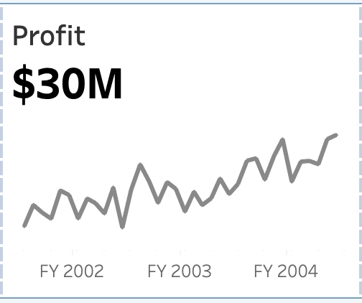
Strong Growth in Orders, Revenue & Profit – AOV Decline Signals Shift in Buying behaviour
Significant increase in orders amount by 189% in 2003 August vs. July – sustaining a strong upward trend
AOV drops 50% in 2003 August vs. July – potentially related to a shift in pricing strategy
Revenue surges 40% in 2003 August vs. July – reinforcing a solid growth momentum
Profit climbs by 36% in 2003 August vs. July – maintaining strong growth

Slide 23
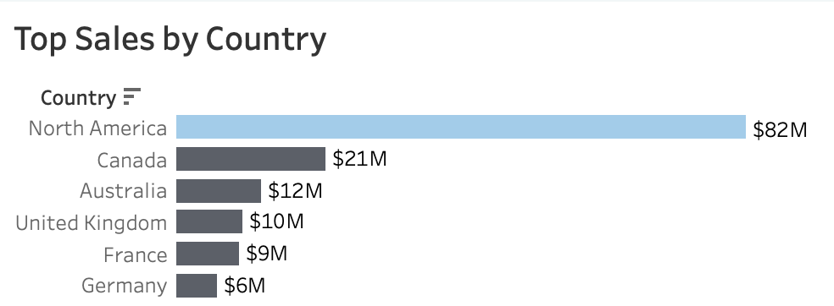
North America Leads in Sales. Is European market a challenge or opportunity?
North America dominate sales, while Europe lags – indicating potential growth opportunities in Europe.

Slide 24
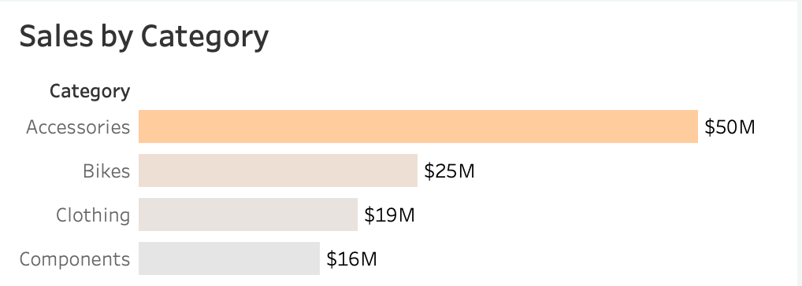
Accessories is the most popular category.

Slide 25
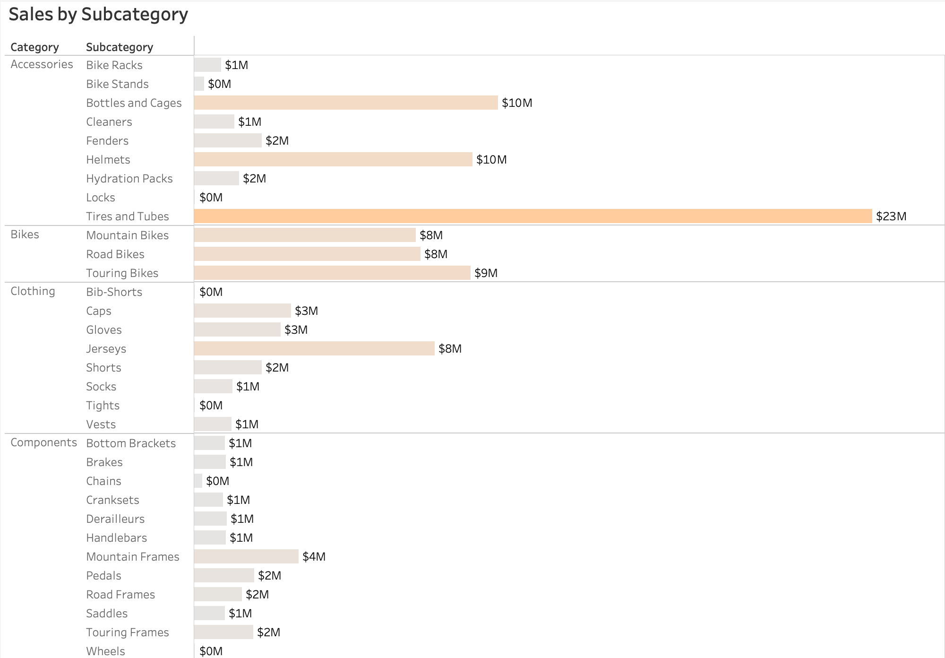
Sales by Subcategory

